Slide 1
Computer Architecture: Weird Machines, Rust, The End
Dr. Colin O’Flynn

Slide 2
Lectures
How does a program run on a machine?
How do you compile from high-level code to machine code?
How does the machine run? (Control Flow)
How does the machine store, access, and control data?
How does the machine execute instructions efficiently?
What other machines & compilers are out there?

Slide 3
Very long instruction word (VLIW)
Instruction words contain everything to do at once
Unlike with superscalar where CPU decides what it can do, or re-orders pipeline
Motivation: the scheduling logic is complicated, why do this in hardware? Make the compiler figure it out!
E.g., the following is one (48-bit) instruction:
f12 = f0 * f4, f8 = f8 + f12, f0 = dm(i0, m3), f4 = pm(i8, m9);

Slide 4
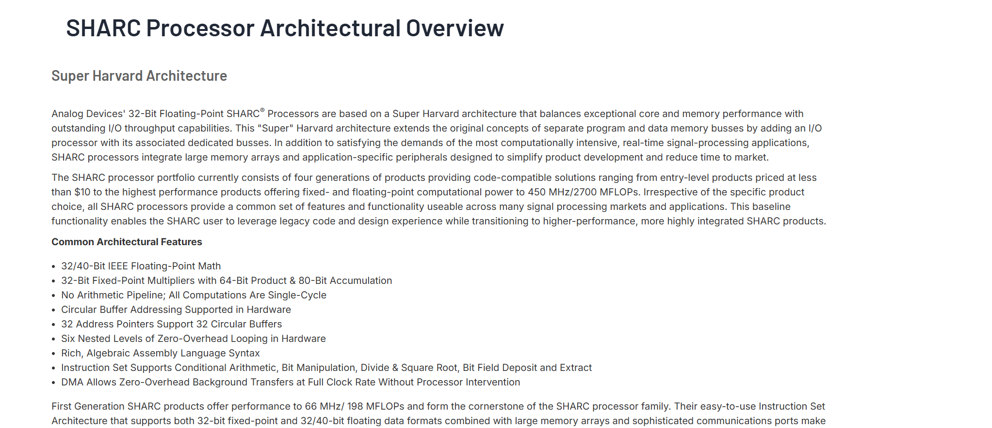
Super Harvard Architecture Single-Chip Computer (SHARC)
https://www.analog.com/en/lp/001/sharc-processor-architectural-overview.html

Slide 5
SHARC Features & Oddities (designed ~1994)
Two register banks (context switching)
Word based addressing (not byte-based)
Instructions can be conditionally executed
Built-in loop support (more on that)
After a branch instruction the next two instructions can be executed (“delay slots)”

Slide 6
Delay Slots
Remember the pipeline problem – why flush away those cycles?
Instead we execute the instructions anyway
Requires us to think about what instructions we want to execute:
loop_start:
add r0, #1
ldr r2, [r0, #8000]
str r2, [r0, #8000]
cmp r0, #5
bne loop_start

Slide 7
Remember: Pipeline with Branch FLUSH
Clock Cycle: 1 2 3 4 5
Fetch
0x00a5d463
0x952e
0x953e
0x8d0d
0x8082
0x00a5d463
0x952e
0x8082
0x8d0d
0x8082
Decode
bge a1,a0,16 <.L3>
add a0,a0,a1
💀
sub a0,a0,a1
Execute
PC =.L3 if a1 ≥ a0
💀
Time
Storage Media
NOTE: in RISC-V a0/a1/etc are general-purpose registers.

Slide 8
Delay Slots: Just Execute Them!!
Clock Cycle: 1 2 3 4 5
Fetch
0x00a5d463
0x952e
0x953e
0x8d0d
0x8082
0x00a5d463
0x952e
0x8082
0x8d0d
0x8082
Decode
bge a1,a0,16 <.L3>
add a0,a0,a1
add a0,a0,a5
sub a0,a0,a1
Execute
PC =.L3 if a1 ≥ a0
a0 += a1
a0 += a5
Time
Storage Media
NOTE: in RISC-V a0/a1/etc are general-purpose registers.

Slide 9
Delay Slots
loop_start:
add r0, #1
ldr r2, [r0, #8000]
str r2, [r0, #8000]
cmp r0, #5
bne loop_start
loop_start:
add r0, #1
cmp r0, #5
bne loop_start
ldr r2, [r0, #8000]
str r2, [r0, #8000]

Slide 10
Fibonacci Example with SHARC
// Calculate the Fibonacci number Fn, n need to be at least 2
int fibonacci(int n) {
int a = 0, b = 1, f;
for (int i = 1; i < n; i++) {
f = a + b;
a = b;
b = f;
}
return f;
}
r2 = 1; // loop counter
r8 = 0;
r12 = 1;
loop_start:
r0 = r8 + r12;
r8 = r12;
r12 = r0;
r2 = r2 + 1;
comp(r2, r4);
if lt jump loop_start;
https://zephray.me/post/sharc_tutorial_2/
8 cycles per iteration (6 instructions + 2 stalls)

Slide 11
Adding Delay Slots
r2 = 1; // loop counter
r8 = 0;
r12 = 1;
loop_start:
r0 = r8 + r12;
r2 = r2 + 1;
comp(r2, r4);
if lt jump loop_start (db);
r8 = r12;
r12 = r0;
6cycles per iteration (no stalls)

Slide 12
Using Loop Counter
r8 = 0;
r12 = 1;
r4 = r4 - 1;
lcntr = r4, do loop_end until lce;
r0 = r8 + r12;
r8 = r12;
loop_end:
r12 = r0;
3 cycles per iteration

Slide 13
Using VLIW Multi-Issue
r8 = 0;
r0 = 1;
r4 = r4 - 1;
lcntr = r4, do loop_end until lce;
loop_end:
r0 = r8 + r0, r8 = r0;
1 cycles per iteration

Slide 14
SHARC Usage
Was used extensively in RADAR and other processing applications
There have been many Digital Signal Processing (DSP) specific architectures in history as that is a more unique challenge
Nowadays you might think of GPU architectures as being similar
SHARC is perhaps a “weird” machine but not a failure. Next…

Slide 15
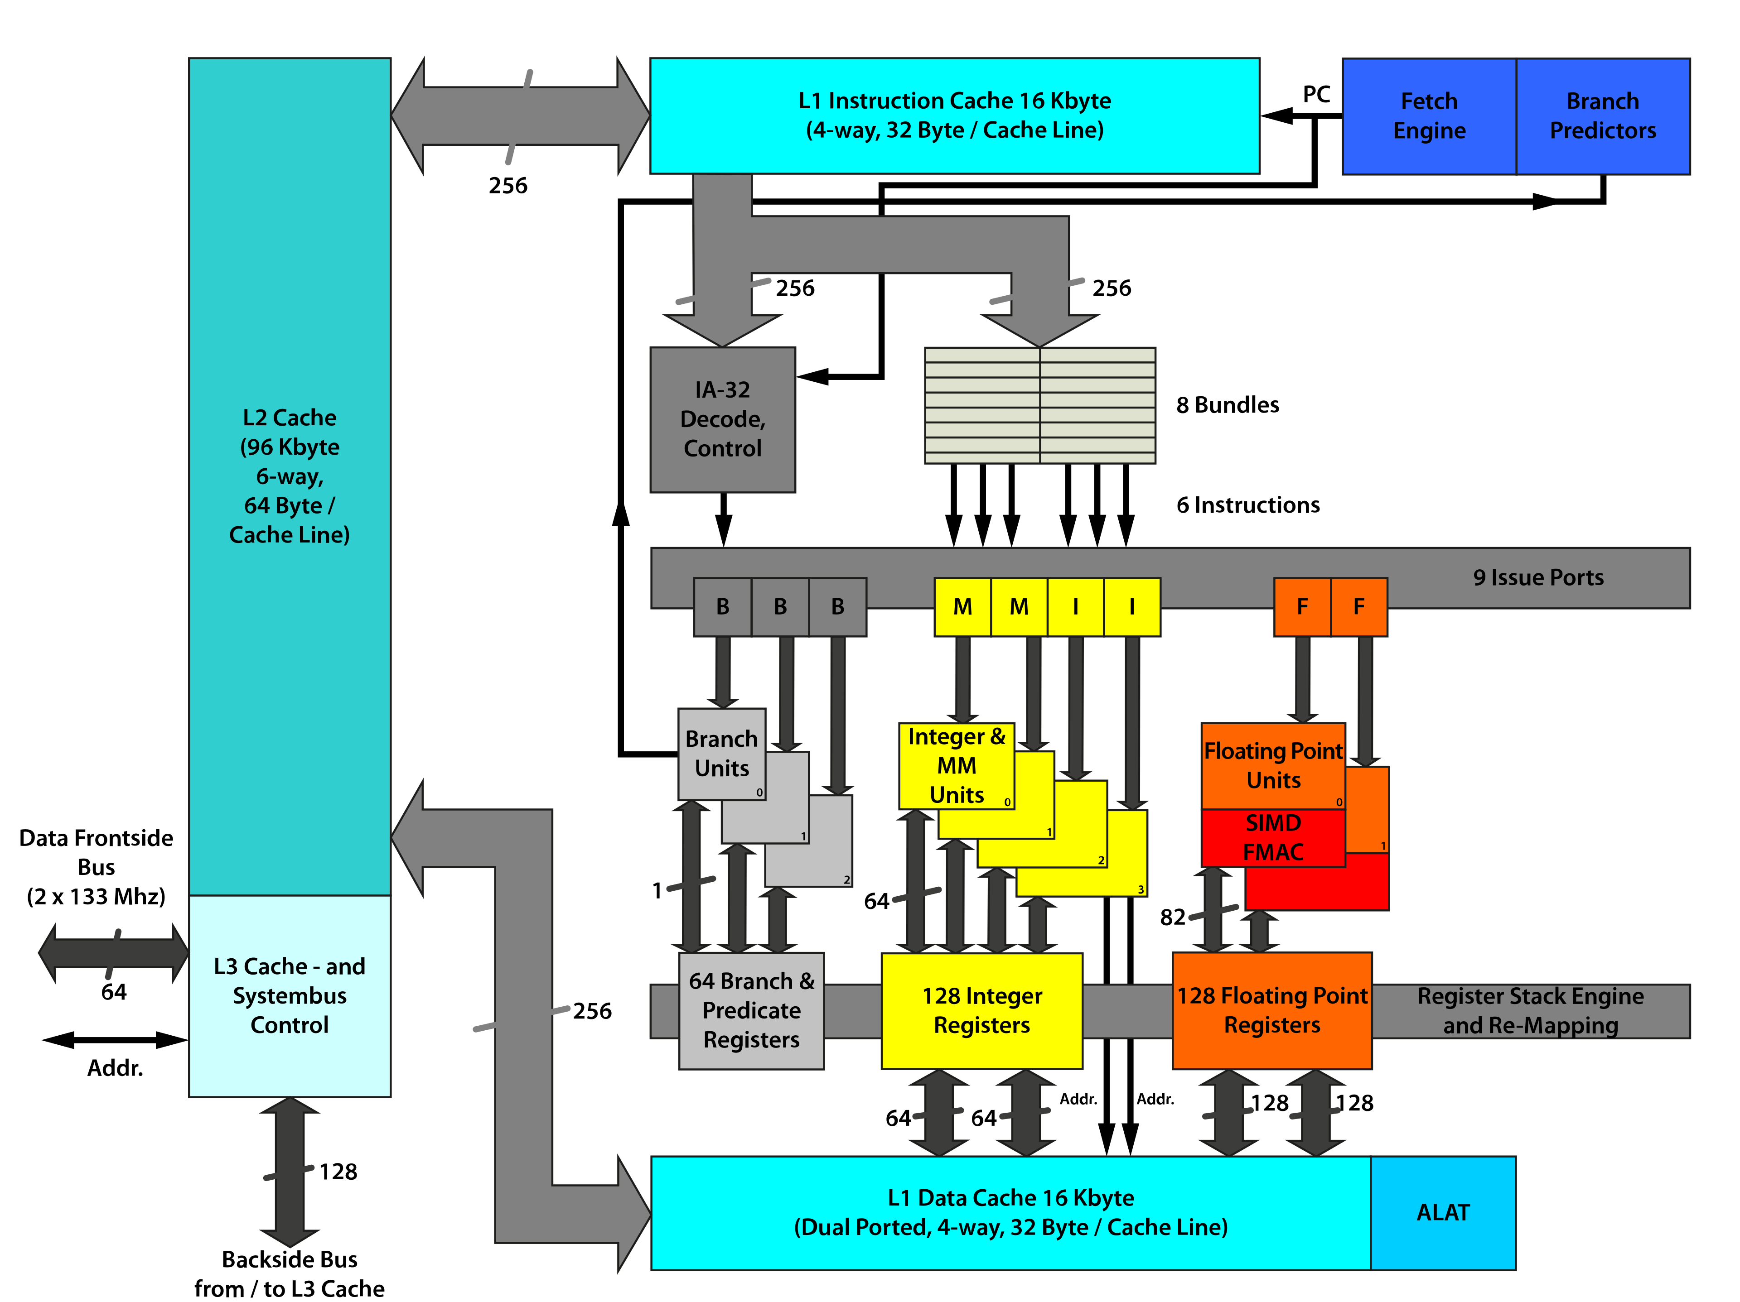
Intel Itanium (“Itanic”) (2001 – 2020)
IA-64: One of the original 64-bit architectures
VLIW → Explicitly parallel instruction computing (EPIC)
The compiler decides what happens in parallel
In “SuperScalar” the CPU decides
By Fred the Oyster, CC BY-SA 4.0, https://commons.wikimedia.org/w/index.php?curid=35228767

Slide 16
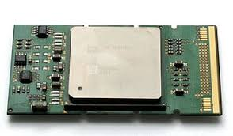
Itanium Failures
Legacy SW was not compatible
Compiler parallelism wasn’t as great as thought
x86-64 shortly arrived – which was compatible
And these cores kept getting better

Slide 17

https://www.theregister.com/2004/08/30/opteron_itanium_sales_q2/

Slide 18
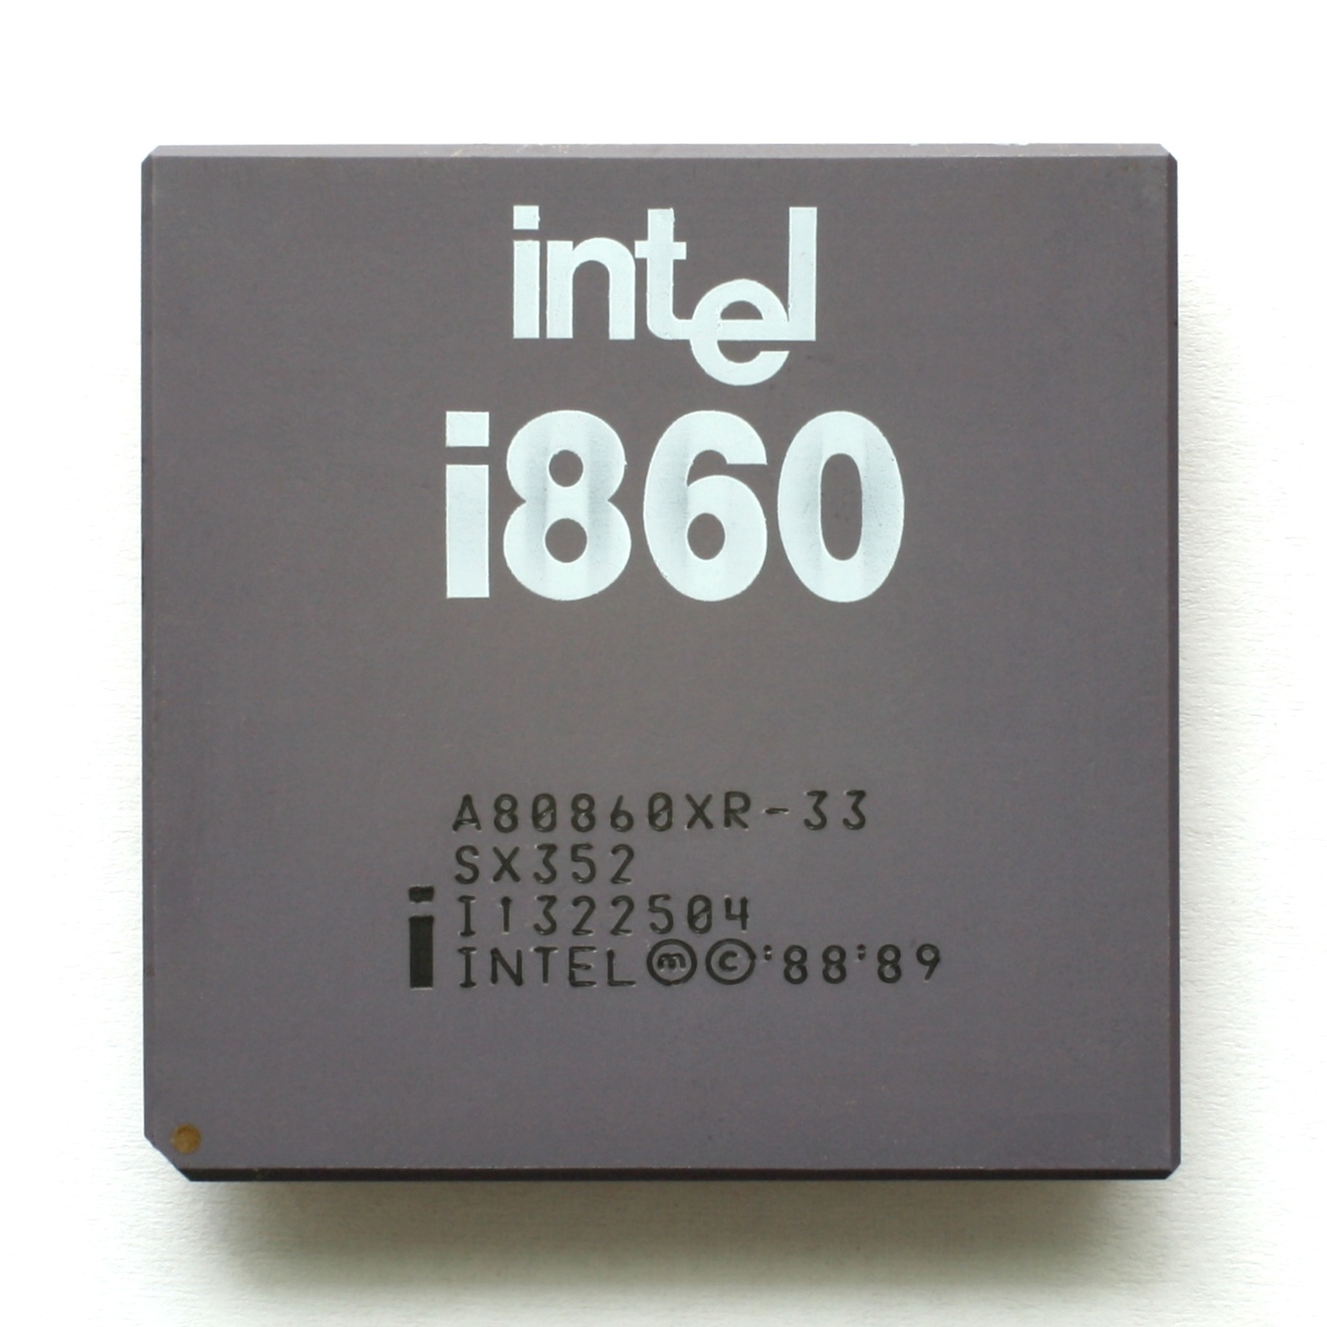
Intel i860 (1980 – mid 1990s)
First million transistor chip
Allowed execution of core (ALU) + floating point instructions simultaneously
VLIW support required for parallel execution

Slide 19
Compiler Problems
High performance should be possible (measured with “Million Floating-point Operations Per Second” = MFLOPS)
Expected up to 80 MFLOPS
..most real programs in assembly (high effort) got ~40 MFLOPS
..compilers even worse ~10 MFLOPS

Slide 20
Compatibility is King!
In both of these cases – the more popular existing systems won
x86 instruction set was so widely used, compilers for x86 much more efficient than the "bespoke" compilers
So….

Slide 21

Transmeta's Crusoe
Let's build an x86 conversion layer… into our chip!
Targeted low-power applications at a time when mobile wasn't very common
Many interesting developments that did get used in the future
But what were they doing?
https://web.archive.org/web/20040701093906/http://www.transmeta.com/

Slide 22
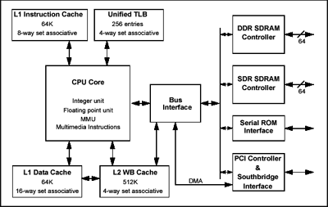
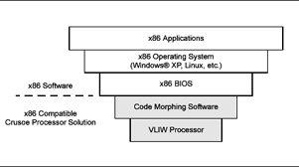
Transmeta's Crusoe

Slide 23
Transmeta LongRun Technology
Adjusted CPU clock frequency & voltage dynamically for workload
Dynamic Voltage and Frequency Scaling (DVFS)
This technology is used extensively in current processors

Slide 24
Java & The Java Virtual Machine (JVM)
Compile for a virtual machine
Compiled code ("bytecode") is portable now
End User
Java object / Bytecode
.java
Source Code
javac
Compiler
Java object / Bytecode
Java Virtual Machine (JVM)
Host Computer
Development Environment

Slide 25
e.g., Java Bytecode
public int add(int, int);
Code:
0: iload_1
1: iload_2
2: iadd
3: ireturn
int add(int a, int b) {
return a + b;
}
https://foojay.io/today/java-bytecode-simplified-journey-to-the-wonderland-part-1/#:~:text=For%20example%2C%20if%20we%20want,%2D%200:%20iconst_3%201:%20ireturn

Slide 26
Java – But Why?
Java was a very popular language for larger embedded systems (more "app-like", smart things, DVD players, etc)
Consider the ecosystem – lots of different processor architectures, Java meant you had portability across them (and for anything that comes later)
There have even been Java processors that implement the JVM in hardware
As defacto standards (Arm, RISC-V) appeared in embedded, Java has become less popular.
Java is still popular in many spaces, included Android app development

Slide 27
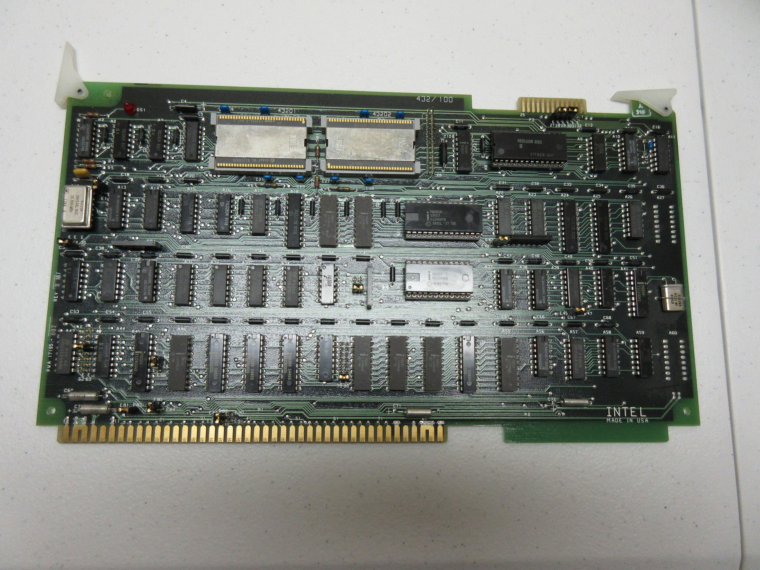
Intel iAPX 432 – Intel's First Failure
We looked at this earlier – it had object oriented hardware implementation that fundamentally made code "safe"
Performance was simply too low – at a time when performance was #1 consideration
Initially only worked / supported with Ada compilers

Slide 28
Ada Programming Language
Created for embedded & real-time systems
Designed to “fundamentally solve” many of the problems that plagued (and still plague) embedded systems:
Memory leaks
Pointer issues
Crashes due to overwriting buffers
Uses strongly typed language features
Pushed by US Military / Government as “The Future of Computer Programming”
Mandated for use in new software for US Military in 1991 (mostly removed by 1997)

Slide 29
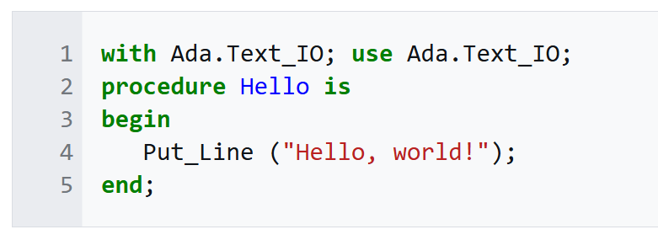
Ada Hello World

Slide 30
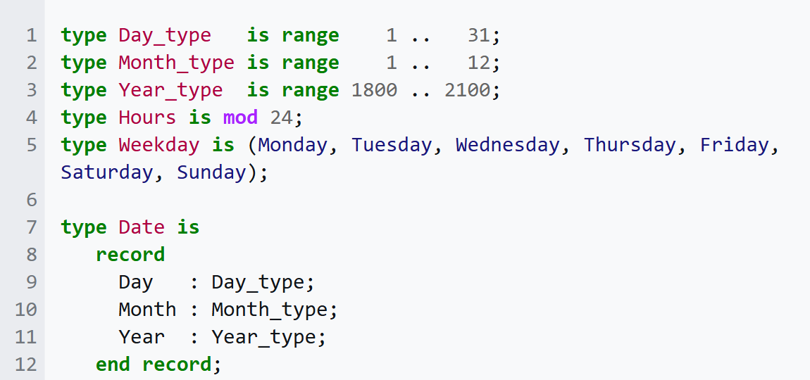
Ada Types

Slide 31
Ada in 2026
The goal of making a safer embedded language has long been a noble pursuit
To wrap this up – let’s introduce something useful for you to know.

Slide 32
The Memory Management Problem
Programs need to store data on the heap — memory that outlives a single function call. The hard question is: who decides when to free it?
Manual (C / C++)
Garbage Collector (Java, Python, Go, C#)
Ownership (Rust)
Advantages:
Advantages:
Advantages:
No runtime overhead at all
Fully predictable timing
Works on hardware with 2KB RAM
Automatic — developer never calls free()
Eliminates most memory errors at runtime
Automatic — freed when owner goes out of scope
Zero runtime cost; compile-time guarantees
Trade-offs:
Trade-offs:
Trade-offs:
Error-prone: leaks, double-free, use-after-free
Developer responsible for every allocation
Runtime pauses, overhead, non-determinism
Large memory footprint; needs OS support
Steeper initial learning curve

Slide 33
How GC Works: Mark & Sweep
The most common GC algorithm. It runs in two phases — and your program must completely stop while this happens.
HEAP
Phase 1: MARK
Roots
Starting from "root" objects (stack variables, static fields), the GC traverses every reachable reference and marks each visited object as live.
E
B
A
F
Reachable — marked LIVE
Unreachable — queued for collection
D
C
Phase 2: SWEEP
G
H
All unmarked objects are freed. The heap reclaims that space. During BOTH phases: your entire program is paused.

Slide 34
The Stop-The-World Pause
To safely traverse the heap, the GC must freeze ALL application threads. No thread may modify object references while the GC is scanning.
App
Thread 1
▶ running
PAUSED
▶ running
PAUSED
▶ running
PAUSED
▶ running
PAUSED
App
Thread 2
GC
Thread
GC
GC
GC
GC
Major GC pause: 50–500ms typical
App running
App paused (STW)
GC thread active

Slide 35
Memory Overhead & Fragmentation
GC-managed runtimes need significantly more memory than your program's actual data — a luxury embedded systems cannot afford.
Relative memory usage (same program, data = 1.0×)
C / Rust
1×
GC Headroom
GC needs 2–3× live data to operate efficiently. At 70%+ heap utilization, performance degrades sharply as GC runs constantly.
Go
2.1×
Fragmentation
Java
2.8×
After many alloc/free cycles, free memory becomes scattered in small chunks. The GC must occasionally "compact" the heap — another STW pause.
Python
5×
Object Overhead
Every heap object carries a header (type tag, GC flags, lock word). A single boolean may cost 16–32 bytes including header and alignment.
Actual program data
GC overhead (metadata, headroom & fragmentation)

Slide 36
Non-Determinism: The Real-Time Killer
With a GC, you cannot predict when collection will run or how long it will take. For real-time systems, this unpredictability is catastrophic.
Rust / C — Deterministic response times:
Every response: ~8ms (consistent, predictable)
GC Language — Non-deterministic response times:
STW Pause
STW Pause
STW Pause
Normal: ~8ms. But GC pauses hit without warning: minor ~10ms, major 100–500ms
Real-time systems must guarantee response within a hard deadline. A GC pause that fires at the wrong moment misses that deadline entirely — causing audio glitches, sensor sampling gaps, or control system failures.

Slide 37
Rust's Ownership Model (GC-free)
Rust's ownership system is enforced at compile time — no runtime checks, no GC, zero overhead.
// 1. Ownership moves on assignment
let v = vec![1, 2, 3]; // v owns the Vec
let w = v; // ownership moves to w
// println!("{:?}", v); // ❌ compile error!
// 2. Borrowing: share without moving
let s = String::from("hello");
let len = compute_len(&s); // borrow s (read-only)
println!("{} len={}", s, len); // s still valid ✓
// 3. Mutable borrow: exclusive access
let mut x = 5;
let r = &mut x; // exclusive mutable borrow
*r += 1; // only r can access x here
println!("{}", x); // borrow ended, x accessible ✓
1
Each value has one owner
When the owner goes out of scope, the value is automatically freed — no malloc/free pairs, no memory leaks by design.
2
You can borrow references
Multiple read-only borrows are allowed, OR one exclusive mutable borrow — but never both at once. Data races become impossible.
3
The compiler enforces everything
Invalid borrows, use-after-free, and data races are caught at compile time, not discovered on hardware

Slide 38
Rust vs C: A Quick Comparison
Feature
C
Rust
Memory Safety
Manual (error-prone)
Compile-time enforced
Garbage Collector
None
None
Data Races
Possible at runtime
Impossible (compile-time)
Abstraction Cost
Low
Zero (monomorphized)
Package Manager
None (ad hoc)
Cargo (built-in)
Error Handling
Return codes / errno
Result<T,E> types
null Pointers
Allowed (segfault risk)
Do not exist (Option<T>)
Embedded Support
Decades of ecosystem
Growing fast, practical now

Slide 39
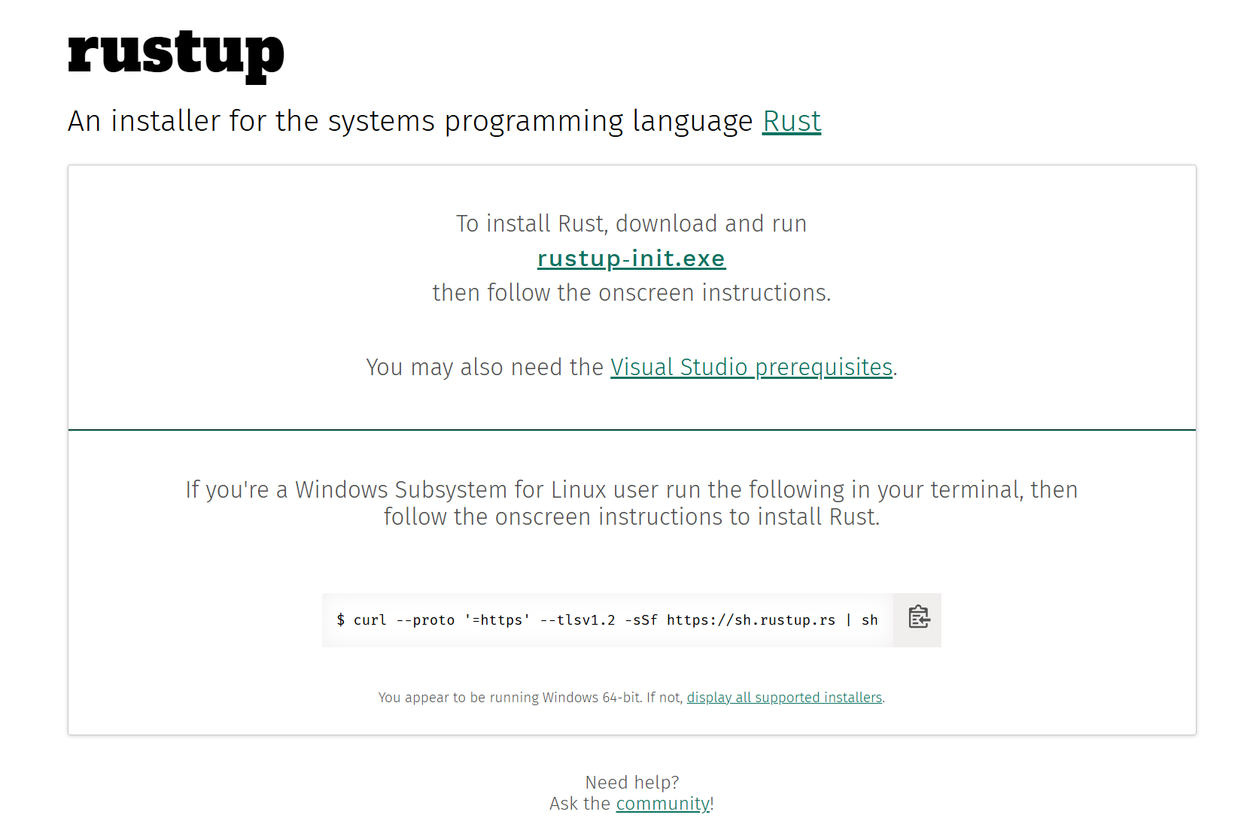
Installing Rust (WSL or Native)

Slide 40
Setting Up Your Environment
1
Install Rust
# Install rustup — the Rust toolchain manager
curl --proto '=https' --tlsv1.2 -sSf \
https://sh.rustup.rs | sh
# Verify
rustc --version && cargo --version
2
Add Cross-Compilation Targets
# Cortex-M4 / M7 with & w/o hardware float (e.g. STM32F3/F4)
rustup target add thumbv7em-none-eabihf thumbv7em-none-eabi
# Cortex-M0 / M0+ (many simpler MCUs)
rustup target add thumbv6m-none-eabi
3
Install Flashing Tools + Embedded Tools etc
# probe-rs-tools gives us cargo-embed and a bunch of stuff
cargo install probe-rs-tools

Slide 41
Example: Blink an LED
The "Hello, World!" of embedded — toggle an LED every 500ms. Target: STM32 Nucleo 303
Peripherals::take() is a one-time call. The type system guarantees you can't accidentally use the same peripheral in two places.
#![no_std]
#![no_main]
use cortex_m::{asm, peripheral::Peripherals as CorePeripherals};
use cortex_m_rt::entry;
use stm32f3xx_hal::{pac, prelude::*};
use panic_halt as _;
#[entry]
fn main() -> ! {
let dp = pac::Peripherals::take().unwrap();
let _cp = CorePeripherals::take().unwrap();
let mut flash = dp.FLASH.constrain();
let mut rcc = dp.RCC.constrain();
let _clocks = rcc.cfgr.freeze(&mut flash.acr);
let mut gpioa = dp.GPIOA.split(&mut rcc.ahb);
let mut led = gpioa.pa5.into_push_pull_output(
&mut gpioa.moder,
&mut gpioa.otyper,
);
loop {
led.set_high().ok();
asm::delay(8_000_000);
led.set_low().ok();
asm::delay(8_000_000);
}
}
into_push_pull_output() returns a typed pin. The type encodes the pin mode — you cannot call set_high() on an input pin.
asm::delay() blocks using a busy-loop counter, can use a HAL delay function as well.
loop {} never exits. Embedded programs run until power is removed — there is no OS to return to.

Slide 42
Example: Send Data Over UART
Print debug messages or sensor readings to a serial terminal — essential for any embedded project.
Key concepts:
#![no_std]
#![no_main]
use cortex_m_rt::entry;
use stm32f4xx_hal::{pac, prelude::*, serial};
use core::fmt::Write;
use panic_halt as _;
#[entry]
fn main() -> ! {
let dp = pac::Peripherals::take().unwrap();
let rcc = dp.RCC.constrain();
let clocks = rcc.cfgr.sysclk(48.MHz()).freeze();
let gpioa = dp.GPIOA.split();
let tx = gpioa.pa2.into_alternate::<7>();
let rx = gpioa.pa3.into_alternate::<7>();
let serial = dp.USART2.serial((tx, rx), 115_200.bps(), &clocks).unwrap();
let (mut tx, _rx) = serial.split();
for count in 0u32.. {
writeln!(tx, "count = {}", count).ok();
}
}
Type-safe pin config
into_alternate::<7>() selects UART alternate function at compile time. Wrong number = compiler error before you even flash.
core::fmt::Write
The Write trait provides writeln! for any "writer" type. Works just like println! but writes to your serial port.
.split()
Separates the serial port into independent TX and RX with their own ownership — prevents misuse.
.ok() vs .unwrap()
writeln!(...).ok() silently ignores errors (e.g. TX buffer full). Use .unwrap() during debugging to catch issues.

Slide 43
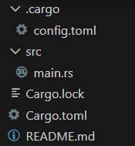
Building Blink For Real: Cargo
[build]
target = "thumbv7em-none-eabihf"
[target.thumbv7em-none-eabihf]
runner = "probe-rs run --chip STM32F303RETx" # optional: flash & run
rustflags = ["-C", "link-arg=-Tlink.x"]
[package]
name = "blinky"
version = "0.1.0"
edition = "2021"
[dependencies]
cortex-m-rt = "0.7"
cortex-m = "0.7" # needed for SYST-based delay
stm32f3xx-hal = { version = "0.10", features = ["stm32f303xe"] }
panic-halt = "0.2"
[profile.release]
opt-level = "s" # optimize for size
lto = true

Slide 44
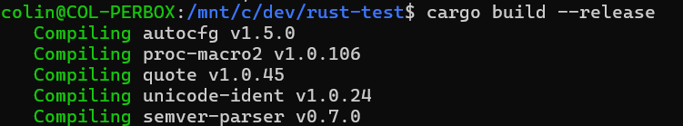

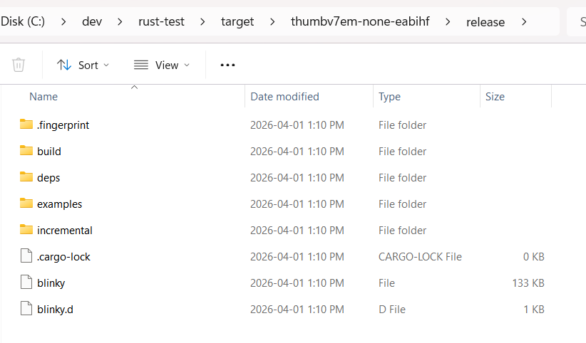
Building Blinky For Real: Cargo
<REMOVED LONG OUTPUT>
This generates an ELF file in target\thumbv7em-none-eabihf\release
blinky is a .elf file – note NO EXTENSION

Slide 45
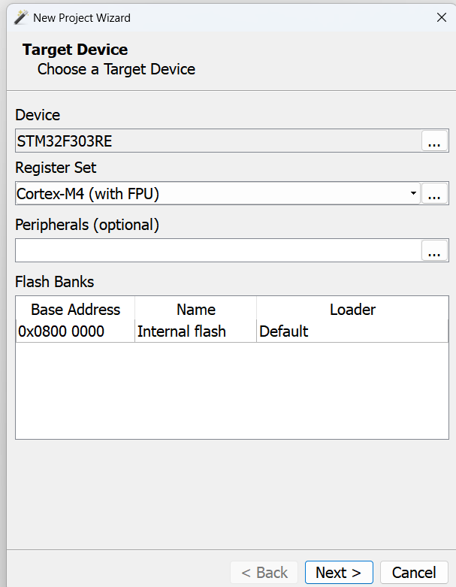
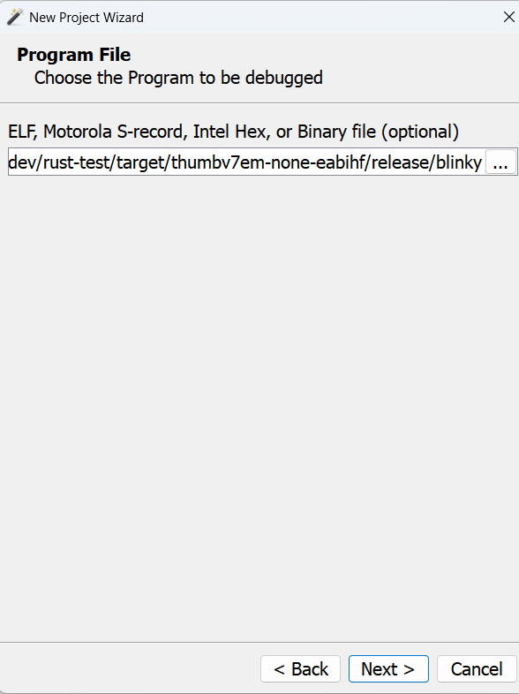
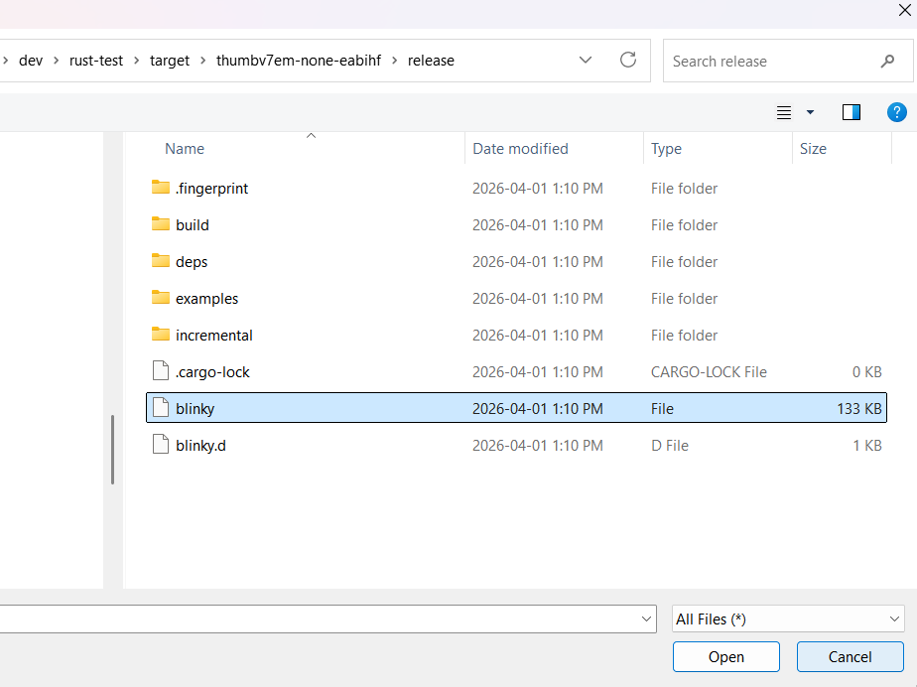
Programming Blinky
If you have a normal st-link you can use the probe-rs tool to program it!
My Nucleo is a J-Link so have to do via Segger O-Zone
Set to “All Files” or rename the blinky to blinky.elf

Slide 46
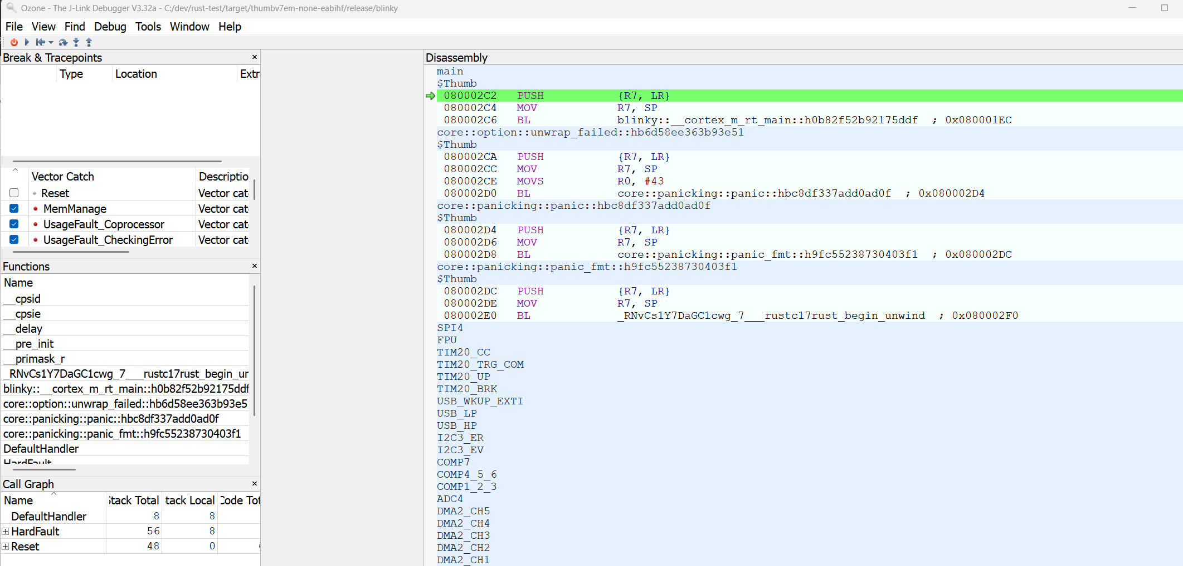
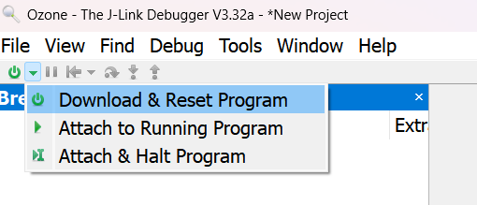
Programming Blinky (Cont’d)
My Nucleo is a J-Link so have to do via Segger O-Zone

Slide 47
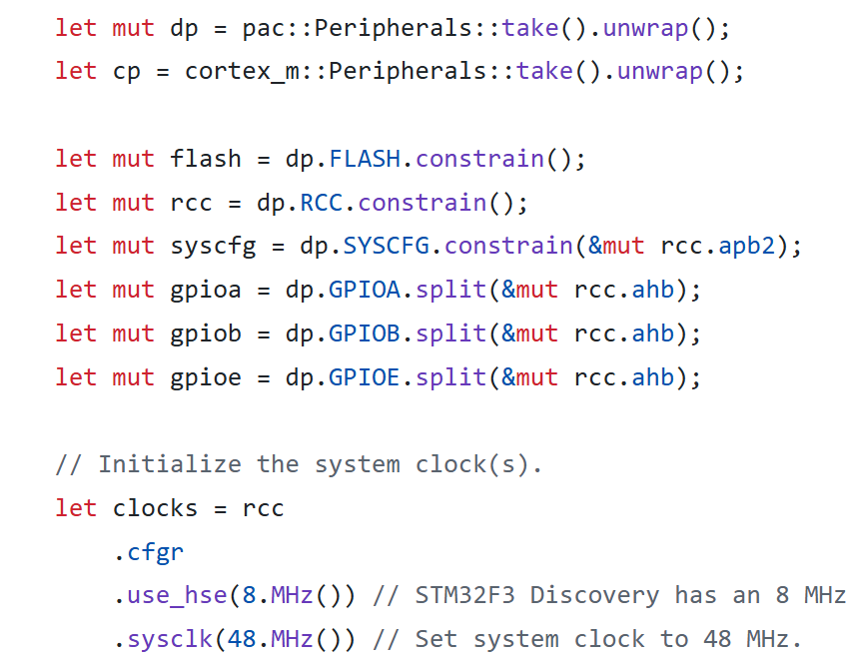
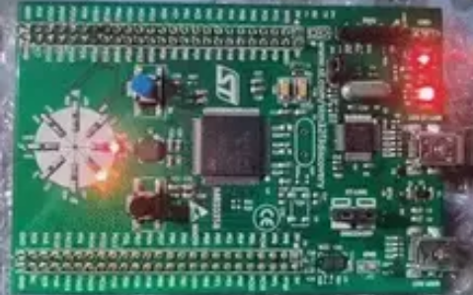
Example: More Complex Rust Program
https://github.com/sunsided/stm32f3disco-rust/blob/main/src/main.rs

Slide 48
More Rust Resources
Documentation & Books
Get Started Today
The Embedded Rust Book — book.rust-lang.org (free, official)
Discovery Book — beginner projects for STM32 and micro:bit
embassy.dev — Embassy framework docs with lots of examples
rtic.rs — RTIC real-time concurrency framework docs
Pick a board: STM32 Nucleo, Raspberry Pi Pico, or BBC micro:bit
awesome-embedded-rust on GitHub — curated list of crates
Rust Embedded Matrix channel — Commonly referenced community to ask questions (disclaimer: no personal experience)
embassy/examples/ on GitHub — Many more working code examples

Slide 49
Continuing Your Embedded Journey
This is the end of Computer Architecture – hopefully you have a good foundation of why and how embedded systems work.
If looking for more experience – the very low cost of boards like our STM32F3 Nucleo board and ESP32 boards can be a great starting point!

